Slide 1
IBM University Engagement Project Submission
“Exploring the Power of Machine Learning with IBM Cloud”

Slide 2

Project Tile – Predictive Maintenance of Industrial Machinery
Domain of Project – Industry
Student Name | Recent Passport Photo | Email ID | Mobile number [WhatsApp]
Shubhamkumar Patil |  | shubham20387@gmail.com | 9860697631

Slide 3
Problem Statement -
Predictive Maintenance of Industrial Machinery
Develop a predictive maintenance model for a fleet of industrial machines to anticipate failures before they occur. This project will involve analyzing sensor data from machinery to identify patterns that precede a failure. The goal is to create a classification model that can predict the type of failure (e.g., tool wear, heat dissipation, power failure) based on real-time operational data. This will enable proactive maintenance, reducing downtime and operational costs.

Slide 4
Proposed Solution -
The proposed solution leverages Machine Learning (ML) to implement a proactive, data-driven approach for predicting industrial machinery failure before it occurs. By continuously monitoring critical operational parameters—such as air temperature, process temperature, rotational speed, torque, and tool wear—the system effectively captures the complex, non-linear relationships that precede equipment breakdown. Built and deployed within the scalable framework of IBM Watson Studio on the IBM Cloud, this solution utilizes advanced classification algorithms to analyze real-time and historical sensor telemetry. By mapping these specific data points against known failure modes, the ML model successfully detects anomalies, estimates structural degradation, and forecasts potential faults. This automated predictive capability transforms traditional maintenance workflows from a reactive or rigidly scheduled routine into an optimized, condition-based strategy, thereby significantly minimizing unplanned downtime, reducing operational costs, and extending the lifespan of vital industrial assets.

Slide 5
Technology Used
IBM Cloud – It provides the infrastructure to build, deploy, and scale the Nutrition Agent efficiently. IBM Cloud enables a reliable, secure, and scalable environment for deploying the Nutrion agent
ML Algorithm/ Model Used: Batched tree Ensemble classifier
Accuracy Obtained: 0.979
Enhancements and Hyperparameter tuning: HPO-1, FE, HPO-2, BATCH

Slide 6
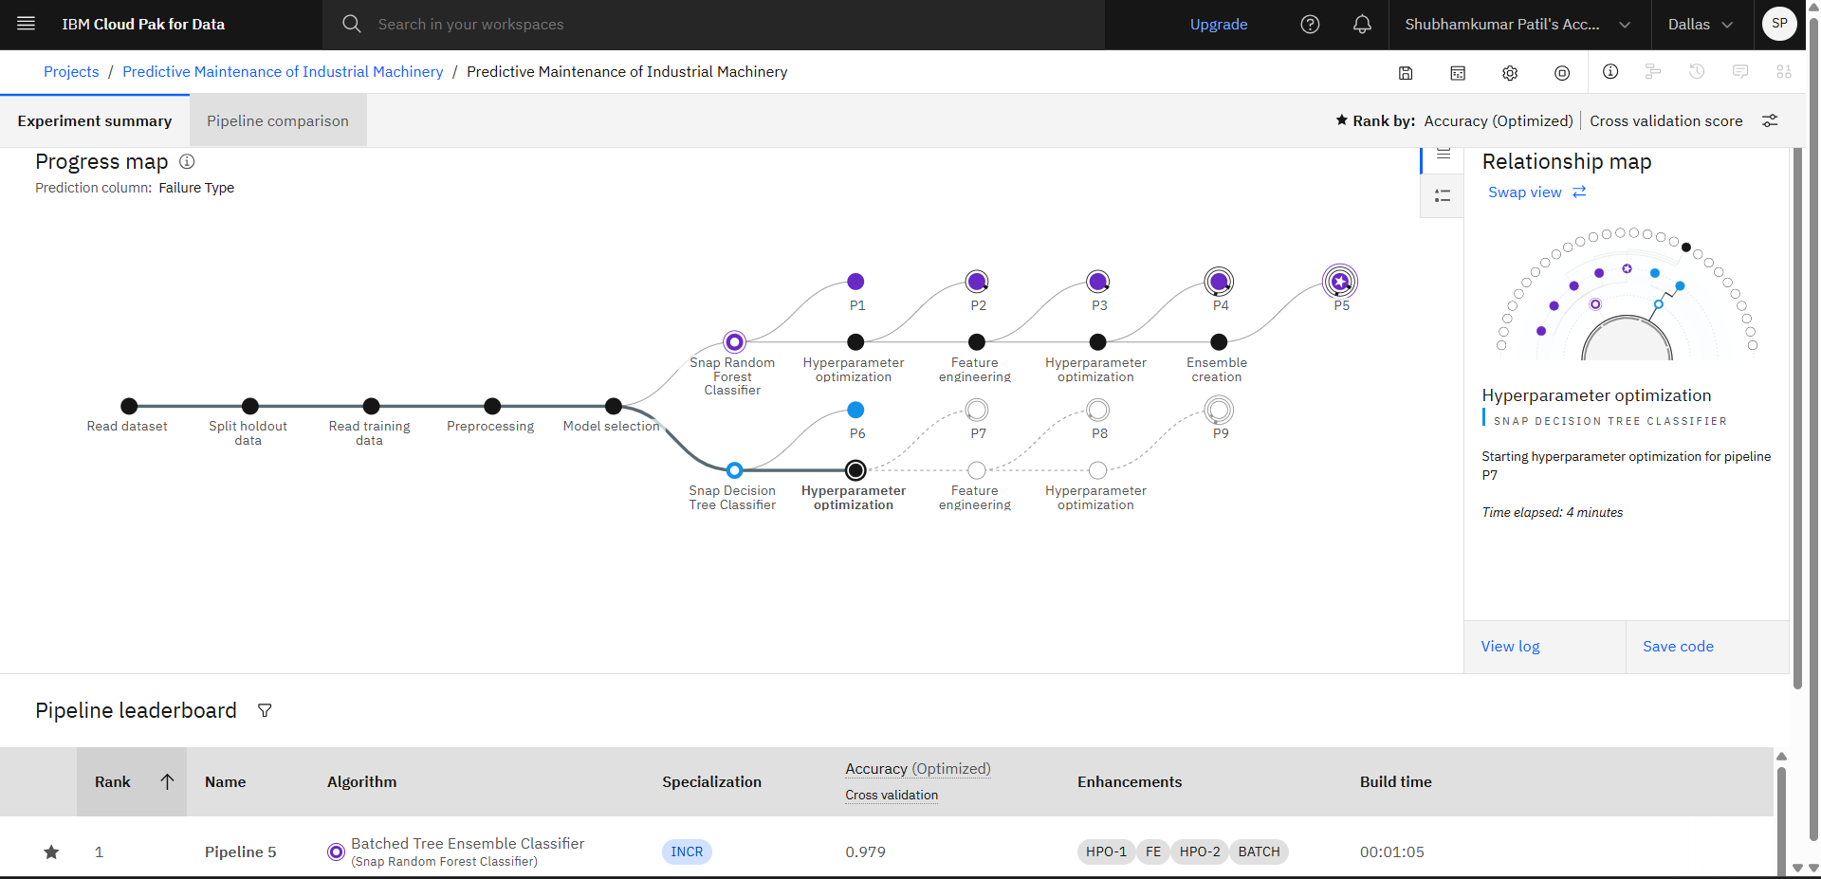
Training Screenshots-

Slide 7
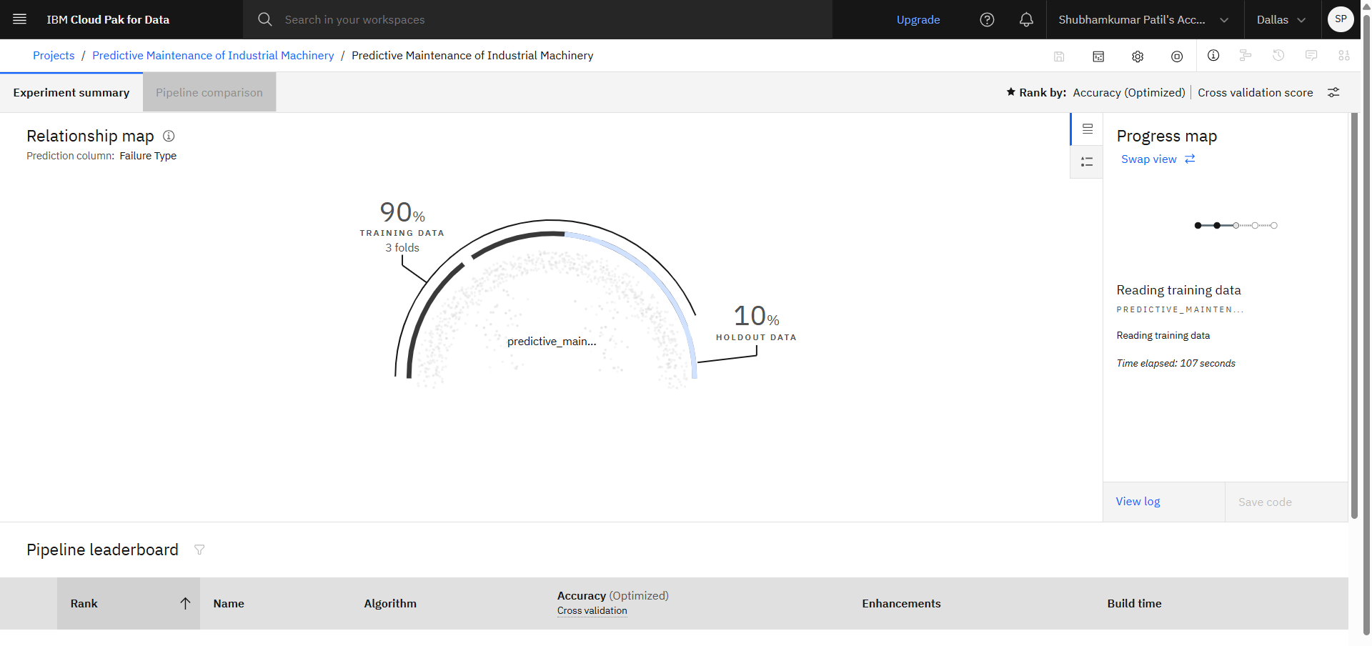
Training Screenshots-

Slide 8
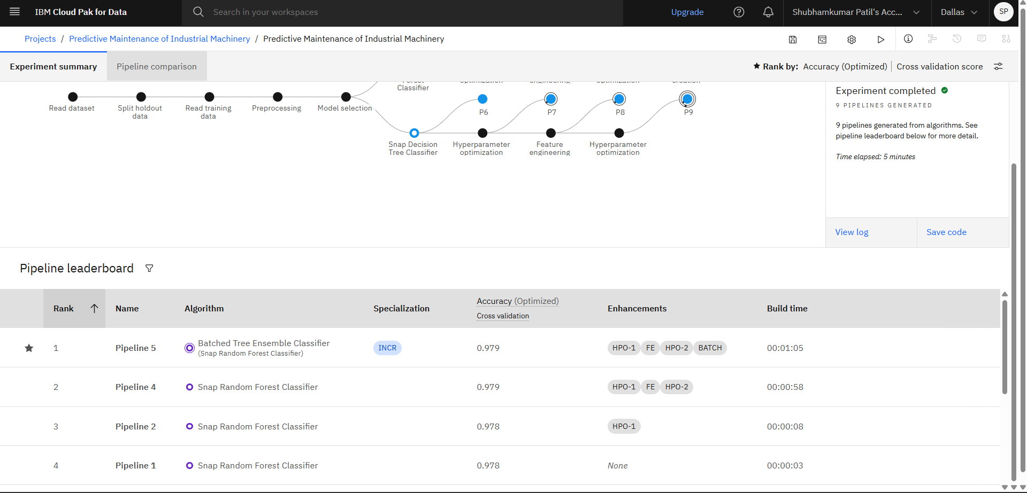
Best Model Screenshot:

Slide 9
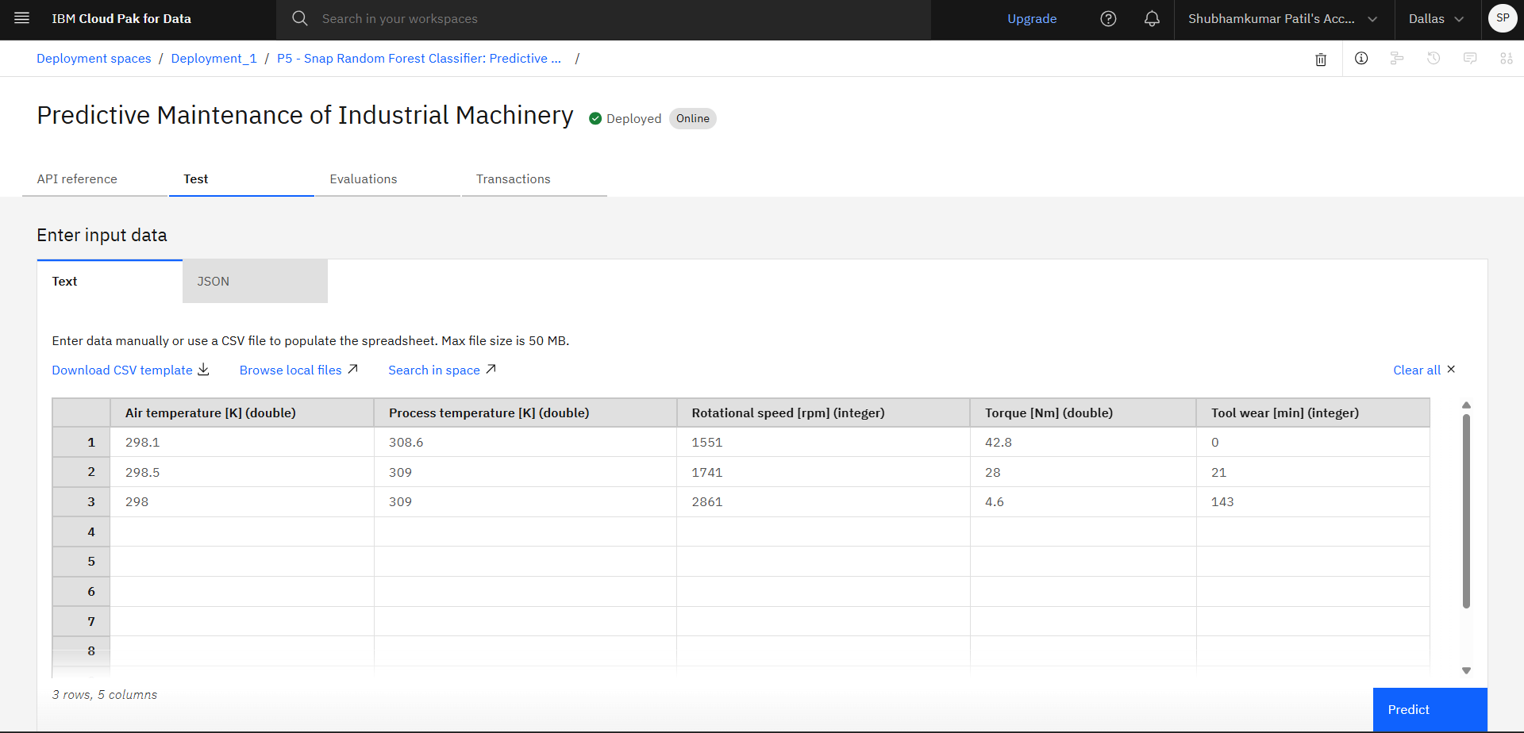
Testing Screenshot:

Slide 10
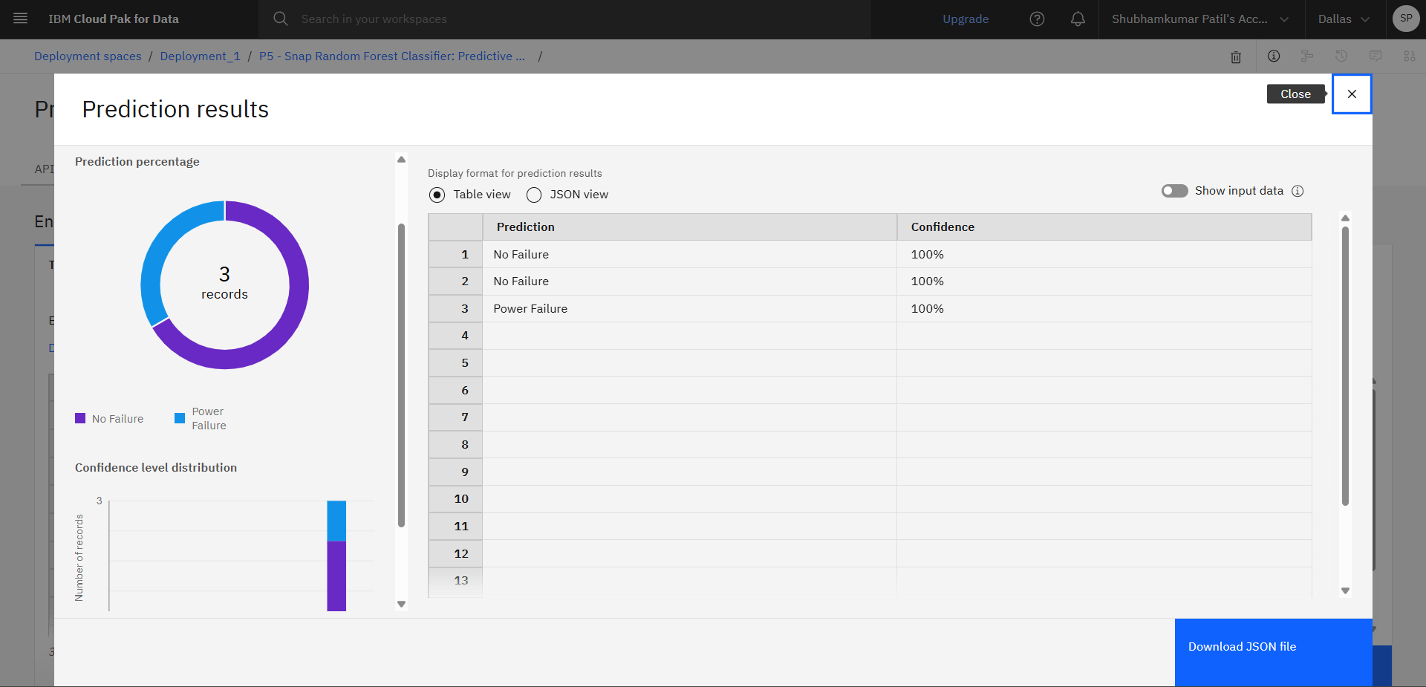
Testing Screenshot:

Slide 11
Uniqueness
Cloud-Native Scalability: Leverages the robust infrastructure of IBM Cloud and IBM Watson Studio to handle high-volume, real-time industrial sensor streams seamlessly.
Multi-Parametric Synthesis: Evaluates a diverse array of thermodynamic and mechanical variables simultaneously to detect complex, interconnected fault indicators that single-sensor systems miss.
Granular Precision: Transitions operational strategy from generic, time-based maintenance intervals to precise, condition-based interventions tailored to actual machine wear.
Proactive Defect Mapping: Links real-time telemetry directly to specific failure modes, allowing facilities to identify not just when a breakdown will occur, but why.
Seamless Workflow Integration: Converts raw, multi-sensor data into immediate, actionable predictive insights without disrupting existing factory floor operations.

Slide 12
Git Hub Link
Please create public github repository (Enable Add README button while creating repository) with format –
Please test and Paste the working Github URL –
https://github.com/shubham20387/IBM-ML-project
Make sure you have Uploaded following three files into your github repository 1) Data.csv file, 2) yourproblemstatement.pdf file 3) your project presntation.pptx file 4) Python Notebook downloaded from IBM Cloud
·
·
·

Slide 13
Future Scope
Edge AI Deployment: Integrating the trained models directly onto localized edge computing devices for real-time, low-latency fault prediction without relying on constant cloud connectivity.
Prescriptive Maintenance Action: Advancing the system from predicting failures to automatically recommending specific troubleshooting steps and auto-generating repair work orders.
Digital Twin Synchronization: Integrating the machine learning models into a fully dynamic 3D digital twin of the factory floor to simulate operational stress and visualize degradation in real-time.
Cross-Fleet Transfer Learning: Applying knowledge gained from existing machinery to newly installed equipment with minimal historical data, accelerating system deployment and accuracy.
Automated Supply Chain Integration: Linking predictive failure insights directly with inventory management systems to autonomously order replacement parts before a component actually breaks down.
·
·
·

Slide 14
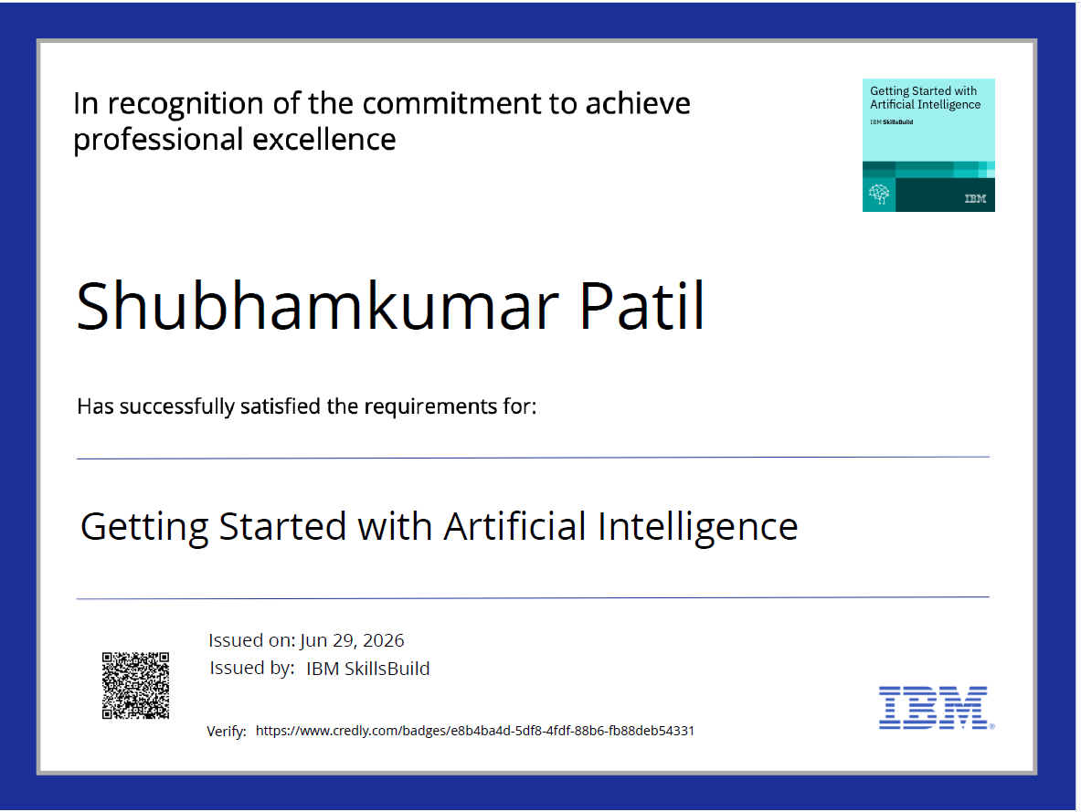
Certificates Earned:

Slide 15
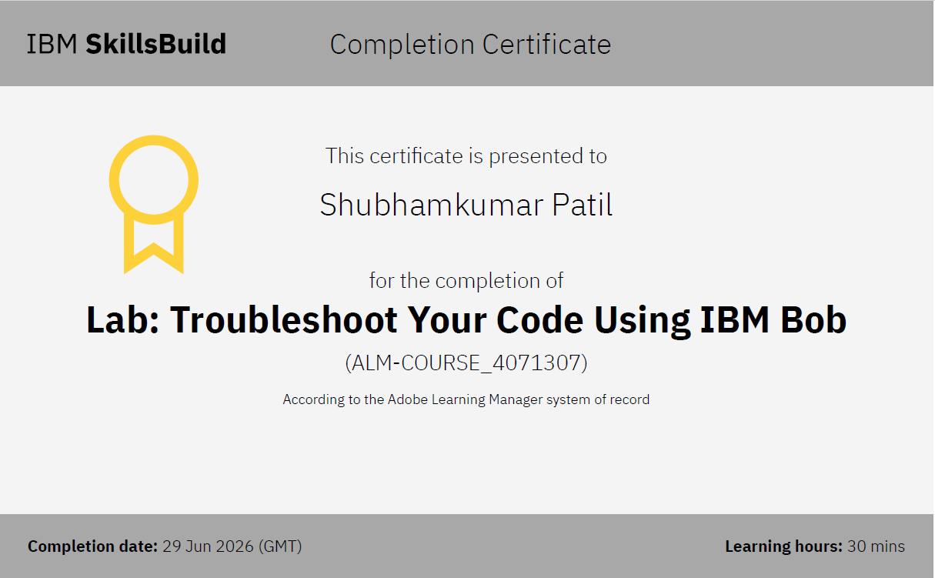
Certificates Earned:​

Slide 16


